Slide 1
Developing Guidelines and Best Practices for Data Visualization Instruction & Pedagogy CASE STUDY: Mapping Community Health Data with PolicyMap and Hispanic & Latinx populations in Los Angeles County
Amy Sonnichsen
Digital Initiatives Librarian
Mount Saint Mary’s University Los Angeles

Slide 2
BROAD AREAS OF FOCUS Data Literacy Visual Literacy Data Ethics Social Constructs (maps, race, class, morality) Digital Humanities Pedagogy Data Visualization - General GIS and Cartography Health Data Visualization | TOPICS IN GIS & HEALTH Choropleth maps Mapping health disparities Health services accessibility Spatial epidemiology Spatiotemporal clustering & analysis Small area estimation Bayesian analysis Geo-coding
VARIABLES & VULNERABILITIES FOR CONSIDERATION (From Critical Issues in Health & Medicine Series) Race Gender Ethnicity Sexuality Culture | PERSPECTIVES (From Critical Issues in Health & Medicine Series) Political Legal Historical Sociological Comparative

Slide 3
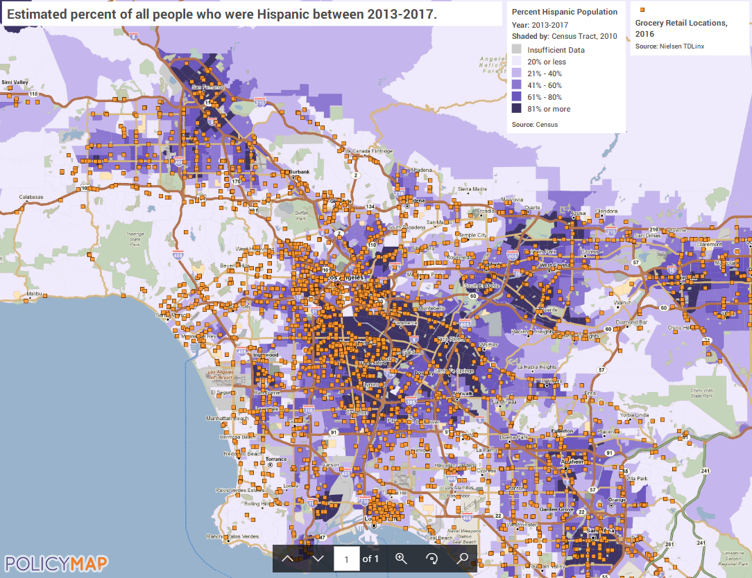
Identifying Food Deserts – Mapping Grocery Retail Locations (all types) and Hispanic Population (estimated 2013-2017)

